Slide 1
OA3103: Data Analysis
Leverage and Interaction of Predictors

Slide 2
Admin
No lab session today
(Short) lab assignment will be posted tomorrow

Slide 3
References
ISLP/R: Chapter 3.2 and 3.6
TALR: Chapter 17
Advanced Regression – Categorical X variables and interaction terms. zedstatistics: https://www.youtube.com/watch?v=HSHcIHMxhbE

Slide 5
Reflections on Yesterday’s Video?

Slide 6
Reflections on Yesterday’s Video?
Coefficients of indicator/binary variables?
Reference Category

Slide 8
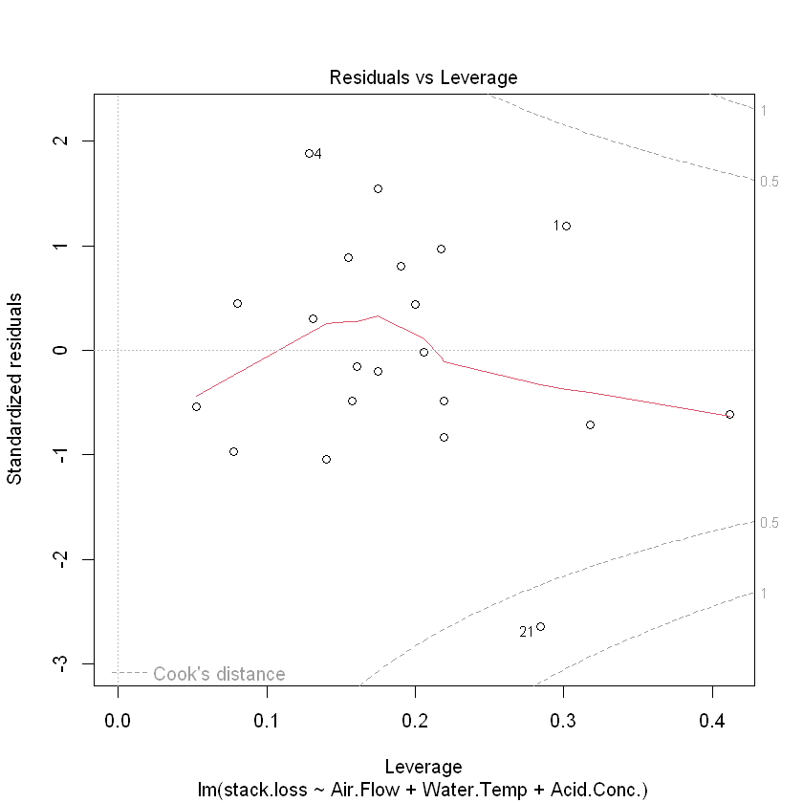
Residuals vs Leverage (Cook’s Distance)
plot(fit, which = 5)

Slide 9
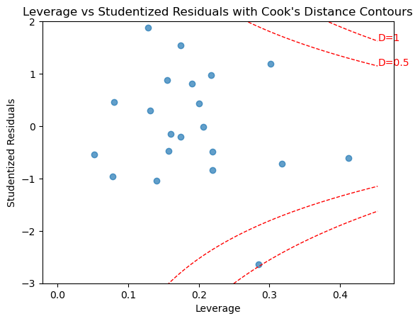
(Studentized) Residuals vs Leverage
Python Version

Slide 10
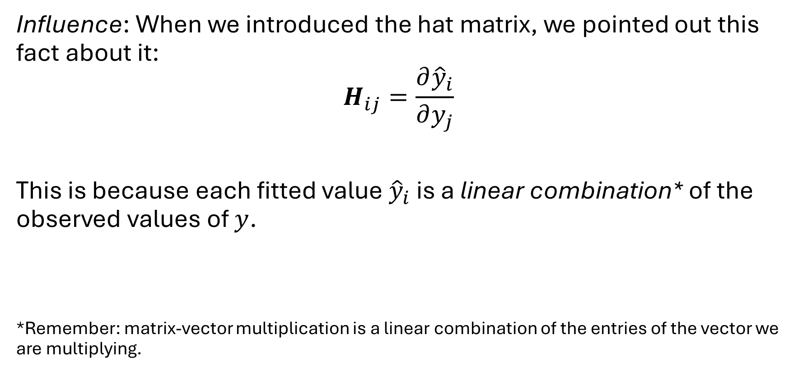
Influence and Leverage
Influence: When we introduced the hat matrix, we pointed out this fact about it:
$$H_{ij}=\frac{∂{\hat{y}}_{i}}{∂y_{j}}$$
This is because each fitted value ${\hat{y}}_{i}$ is a linear combination* of the observed values of $y$.
*Remember: matrix-vector multiplication is a linear combination of the entries of the vector we are multiplying.
Notes:
Leverage tells us how far an observation sits in the predictor space. If a point is far from the center of the X‑values, the model has to ‘reach’ to fit it — and that point gets more leverage.
Mathematically, leverage comes from the hat matrix, H. The diagonal entry $h_{i}$tells us how much the fitted value ${\hat{y}}_{i}$depends on its own observed value $y_{i}$.
If $h_{i}$is large, that point has a lot of pull on the regression line. It’s not necessarily a bad point — it’s just in a part of the predictor space where the model has fewer neighbors to stabilize the fit.
The trace of H is $p+1$, so the average leverage is $\left(p+1\right)/n$. We call a point ‘high leverage’ when its $h_{i}$is noticeably above that average.
High leverage doesn’t automatically mean ‘influential.’ Influence happens when leverage and residual size combine — that’s where Cook’s distance comes in. But leverage alone tells us where the model is most fragile.

Slide 11

Influence and Leverage
Influence: When we introduced the hat matrix, we pointed out this fact about it:
$$H_{ij}=\frac{∂{\hat{y}}_{i}}{∂y_{j}}$$
Translation:
Notes:
Leverage tells us how far an observation sits in the predictor space. If a point is far from the center of the X‑values, the model has to ‘reach’ to fit it — and that point gets more leverage.
Mathematically, leverage comes from the hat matrix, H. The diagonal entry $h_{i}$tells us how much the fitted value ${\hat{y}}_{i}$depends on its own observed value $y_{i}$.
If $h_{i}$is large, that point has a lot of pull on the regression line. It’s not necessarily a bad point — it’s just in a part of the predictor space where the model has fewer neighbors to stabilize the fit.
The trace of H is $p+1$, so the average leverage is $\left(p+1\right)/n$. We call a point ‘high leverage’ when its $h_{i}$is noticeably above that average.
High leverage doesn’t automatically mean ‘influential.’ Influence happens when leverage and residual size combine — that’s where Cook’s distance comes in. But leverage alone tells us where the model is most fragile.

Slide 12
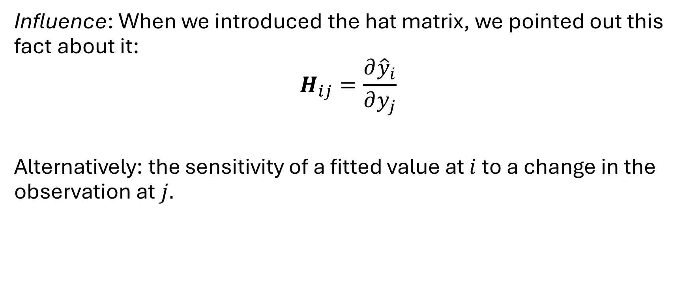
Influence and Leverage
Influence: When we introduced the hat matrix, we pointed out this fact about it:
$$H_{ij}=\frac{∂{\hat{y}}_{i}}{∂y_{j}}$$
Alternatively: the sensitivity of a fitted value at $i$ to a change in the observation at $j.$
Notes:
Leverage tells us how far an observation sits in the predictor space. If a point is far from the center of the X‑values, the model has to ‘reach’ to fit it — and that point gets more leverage.
Mathematically, leverage comes from the hat matrix, H. The diagonal entry $h_{i}$tells us how much the fitted value ${\hat{y}}_{i}$depends on its own observed value $y_{i}$.
If $h_{i}$is large, that point has a lot of pull on the regression line. It’s not necessarily a bad point — it’s just in a part of the predictor space where the model has fewer neighbors to stabilize the fit.
The trace of H is $p+1$, so the average leverage is $\left(p+1\right)/n$. We call a point ‘high leverage’ when its $h_{i}$is noticeably above that average.
High leverage doesn’t automatically mean ‘influential.’ Influence happens when leverage and residual size combine — that’s where Cook’s distance comes in. But leverage alone tells us where the model is most fragile.

Slide 13
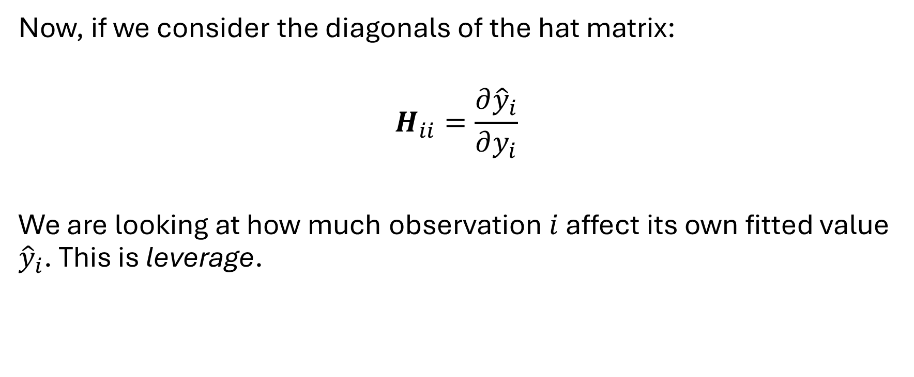
Influence and Leverage
Now, if we consider the diagonals of the hat matrix:
$$H_{ii}=\frac{∂{\hat{y}}_{i}}{∂y_{i}}$$
We are looking at how much observation $i$ affect its own fitted value ${\hat{y}}_{i}$. This is leverage.
Notes:
Leverage tells us how far an observation sits in the predictor space. If a point is far from the center of the X‑values, the model has to ‘reach’ to fit it — and that point gets more leverage.
Mathematically, leverage comes from the hat matrix, H. The diagonal entry $h_{i}$tells us how much the fitted value ${\hat{y}}_{i}$depends on its own observed value $y_{i}$.
If $h_{i}$is large, that point has a lot of pull on the regression line. It’s not necessarily a bad point — it’s just in a part of the predictor space where the model has fewer neighbors to stabilize the fit.
The trace of H is $p+1$, so the average leverage is $\left(p+1\right)/n$. We call a point ‘high leverage’ when its $h_{i}$is noticeably above that average.
High leverage doesn’t automatically mean ‘influential.’ Influence happens when leverage and residual size combine — that’s where Cook’s distance comes in. But leverage alone tells us where the model is most fragile.

Slide 14
Influence and Leverage
The horizontal axis on this plot is the leverage, which is unitless.
Notes:
Leverage tells us how far an observation sits in the predictor space. If a point is far from the center of the X‑values, the model has to ‘reach’ to fit it — and that point gets more leverage.
Mathematically, leverage comes from the hat matrix, H. The diagonal entry $h_{i}$tells us how much the fitted value ${\hat{y}}_{i}$depends on its own observed value $y_{i}$.
If $h_{i}$is large, that point has a lot of pull on the regression line. It’s not necessarily a bad point — it’s just in a part of the predictor space where the model has fewer neighbors to stabilize the fit.
The trace of H is $p+1$, so the average leverage is $\left(p+1\right)/n$. We call a point ‘high leverage’ when its $h_{i}$is noticeably above that average.
High leverage doesn’t automatically mean ‘influential.’ Influence happens when leverage and residual size combine — that’s where Cook’s distance comes in. But leverage alone tells us where the model is most fragile.

Slide 15
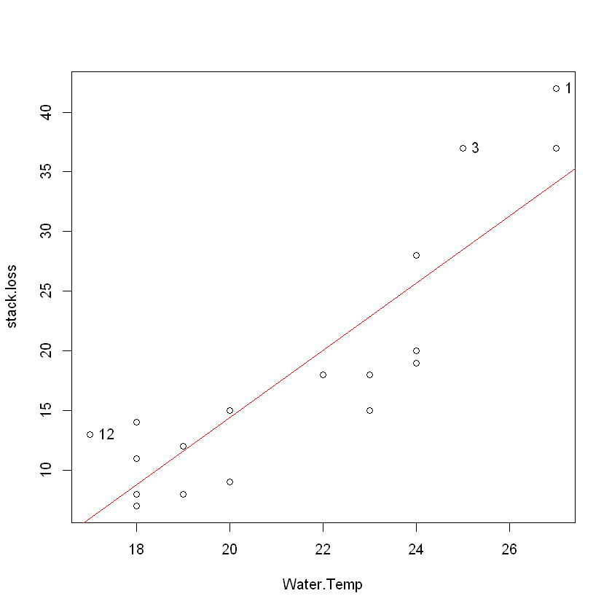
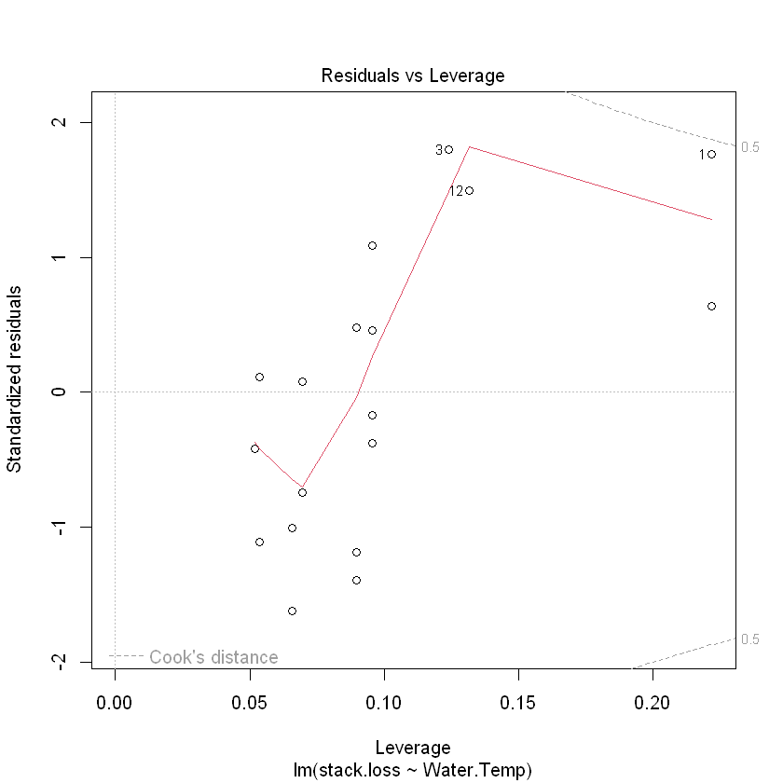
SLR Example

Slide 16
High Leverage
Intuition: High leverage points lie far from the center of mass of the other observations. The linear model has to “reach” further to get to them.
They also have fewer other “nearby” observations to stabilize the regression line near that point.

Slide 17
High Leverage
The horizontal axis on this plot is the leverage, which is unitless.
We look for data points with high leverage.
But what is considered “high?”
Notes:
Leverage tells us how far an observation sits in the predictor space. If a point is far from the center of the X‑values, the model has to ‘reach’ to fit it — and that point gets more leverage.
Mathematically, leverage comes from the hat matrix, H. The diagonal entry $h_{i}$tells us how much the fitted value ${\hat{y}}_{i}$depends on its own observed value $y_{i}$.
If $h_{i}$is large, that point has a lot of pull on the regression line. It’s not necessarily a bad point — it’s just in a part of the predictor space where the model has fewer neighbors to stabilize the fit.
The trace of H is $p+1$, so the average leverage is $\left(p+1\right)/n$. We call a point ‘high leverage’ when its $h_{i}$is noticeably above that average.
High leverage doesn’t automatically mean ‘influential.’ Influence happens when leverage and residual size combine — that’s where Cook’s distance comes in. But leverage alone tells us where the model is most fragile.

Slide 18
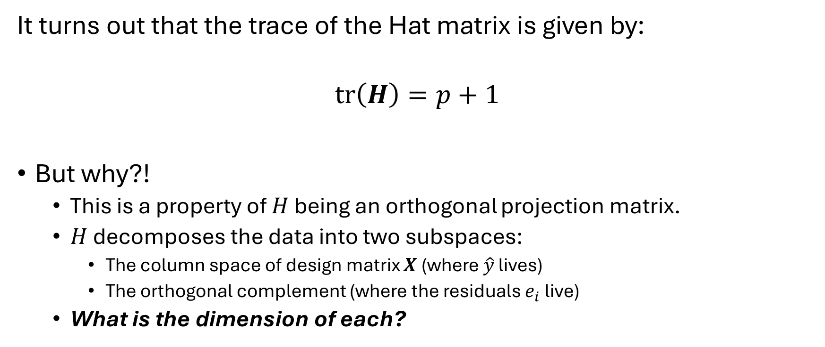
Trace of the Hat Matrix
It turns out that the trace of the Hat matrix is given by:
$$tr\left(H\right)=p+1$$
But why?!
This is a property of $H$ being an orthogonal projection matrix.
$H$ decomposes the data into two subspaces:
The column space of design matrix $X$ (where $\hat{y}$ lives)
The orthogonal complement (where the residuals $e_{i}$ live)
What is the dimension of each?

Slide 19
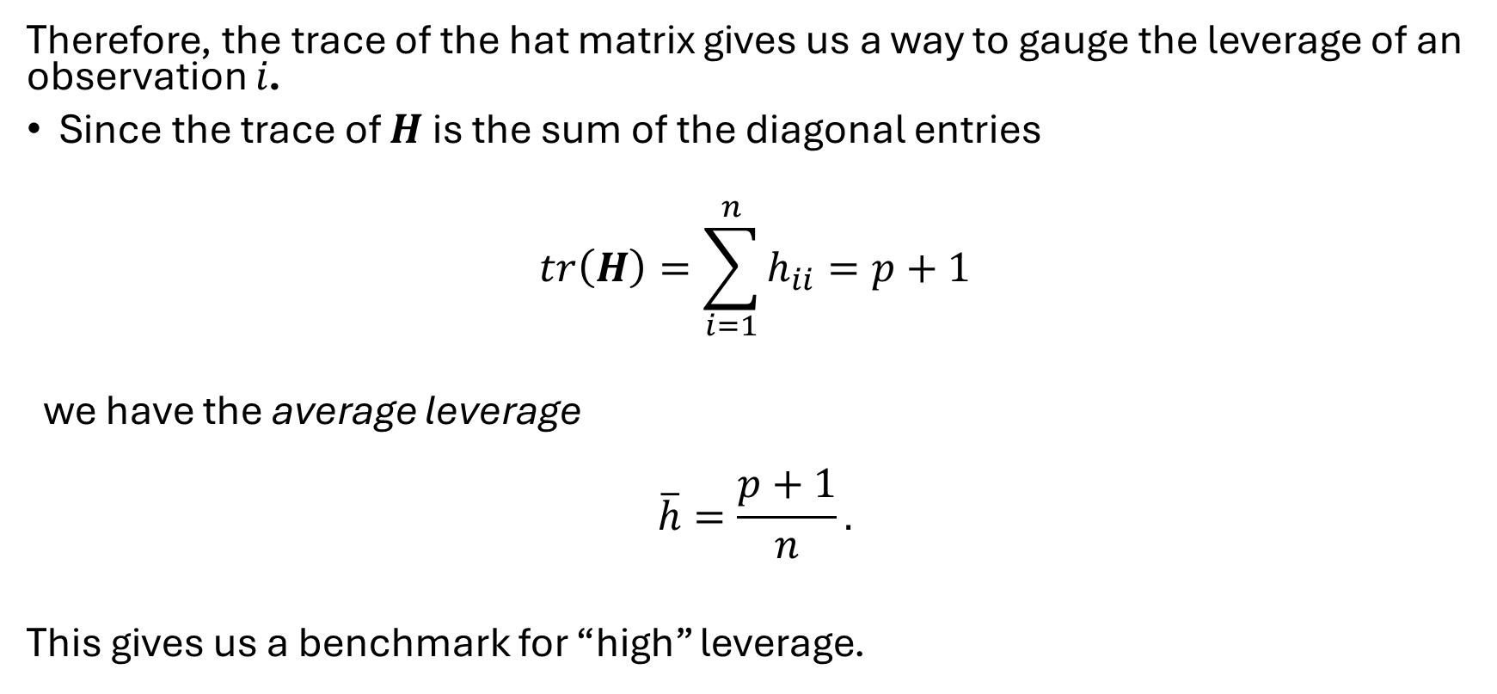
Trace of the Hat Matrix
Therefore, the trace of the hat matrix gives us a way to gauge the leverage of an observation $i$.
Since the trace of $H$ is the sum of the diagonal entries
$$tr\left(H\right)=\sum_{i=1}^{n}{h_{ii}}=p+1$$
we have the average leverage
$$\overline{h}=\frac{p+1}{n}.$$
This gives us a benchmark for “high” leverage.

Slide 20

Trace of the Hat Matrix
$$\overline{h}=\frac{p+1}{n}.$$
This gives us a benchmark for “high” leverage.
Textbooks and software typically use 2x or 3x $\overline{h}$ as thresholds.

Slide 21
Back to the stackloss data:

Slide 22
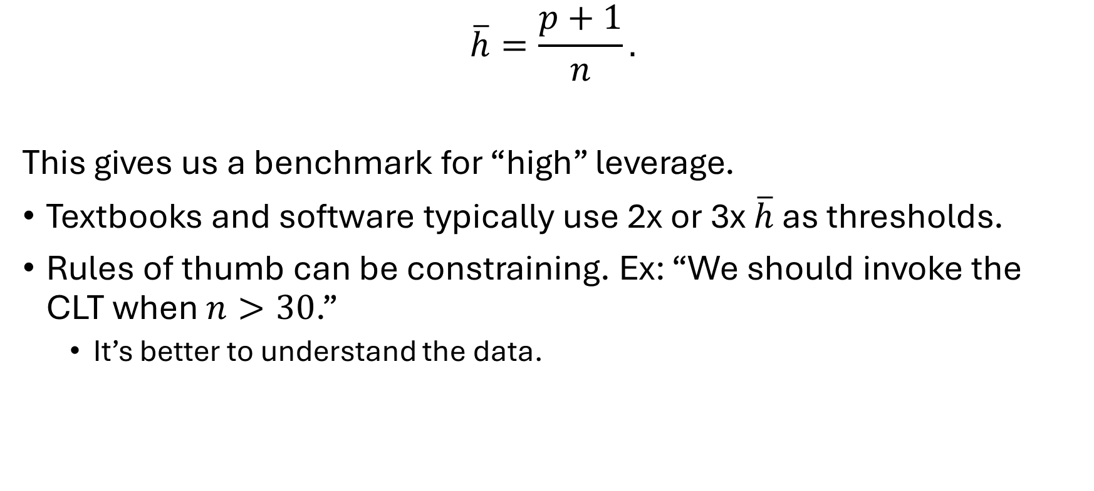
Average Leverage
$$\overline{h}=\frac{p+1}{n}.$$
This gives us a benchmark for “high” leverage.
Textbooks and software typically use 2x or 3x $\overline{h}$ as thresholds.
Rules of thumb can be constraining. Ex: “We should invoke the CLT when $n>30$.”
It’s better to understand the data.

Slide 23
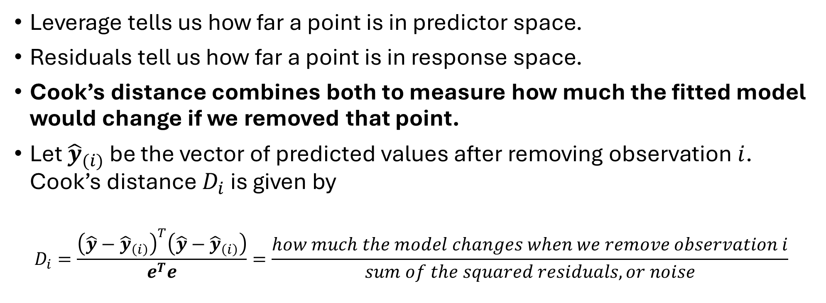
Cook’s Distance
Leverage tells us how far a point is in predictor space.
Residuals tell us how far a point is in response space.
Cook’s distance combines both to measure how much the fitted model would change if we removed that point.
Let ${\hat{y}}_{(i)}$ be the vector of predicted values after removing observation $i$. Cook’s distance $D_{i}$ is given by
$$D_{i}=\frac{{\left(\hat{y}−{\hat{y}}_{\left(i\right)}\right)}^{T}\left(\hat{y}−{\hat{y}}_{\left(i\right)}\right)}{e^{T}e}=\frac{how much the model changes when we remove observation i}{sum of the squared residuals, or noise}$$

Slide 24
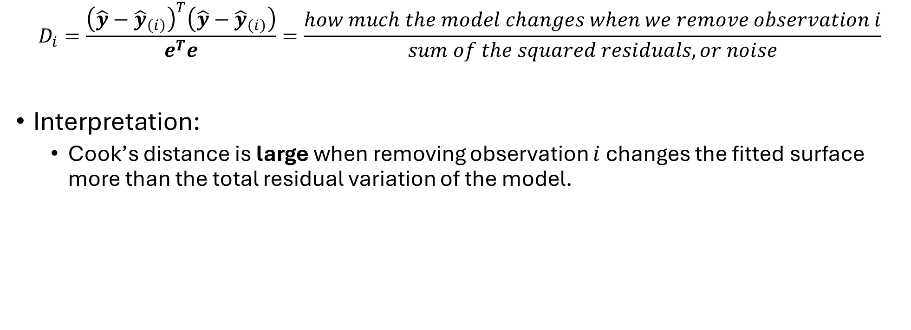
Cook’s Distance
$$D_{i}=\frac{{\left(\hat{y}−{\hat{y}}_{\left(i\right)}\right)}^{T}\left(\hat{y}−{\hat{y}}_{\left(i\right)}\right)}{e^{T}e}=\frac{how much the model changes when we remove observation i}{sum of the squared residuals, or noise}$$
Interpretation:
Cook’s distance is large when removing observation $i$ changes the fitted surface more than the total residual variation of the model.

Slide 25
Back to the stackloss data:

Slide 26
Should We Remove that Highly Influential Point?
As always, it depends.
Starting with EDA allows us to understand what the data is telling us in the first place.
Influential is not the same as “bad”
Sometimes influential points indicate that we are using the wrong model and need a transformation.
Notes:
Influential points are not “mistakes”, just points that the model depends on more heavily than others. The question is whether that dependence is appropriate for our use case.

Slide 27
Keep or Remove?
A data entry error: Someone typed age 400 instead of 40.
An exceptionally tall basketball player in a height dataset.
A large mansion-sized home in a real estate dataset.
A fast aircraft in a performance dataset.
A group of influential points at the beginning and end of a population growth model.
Influential points show up periodically in a temperature vs day of the year relationship with a linear fit.

Slide 28
Should We Remove that Highly Influential Point?
Bottom line:
Can we use the influential points to modify or transform our model?
Does removing the observation support repeatable results, and is it defensible to do so?
This is where your judgment as an operations analyst come into play.

Slide 30
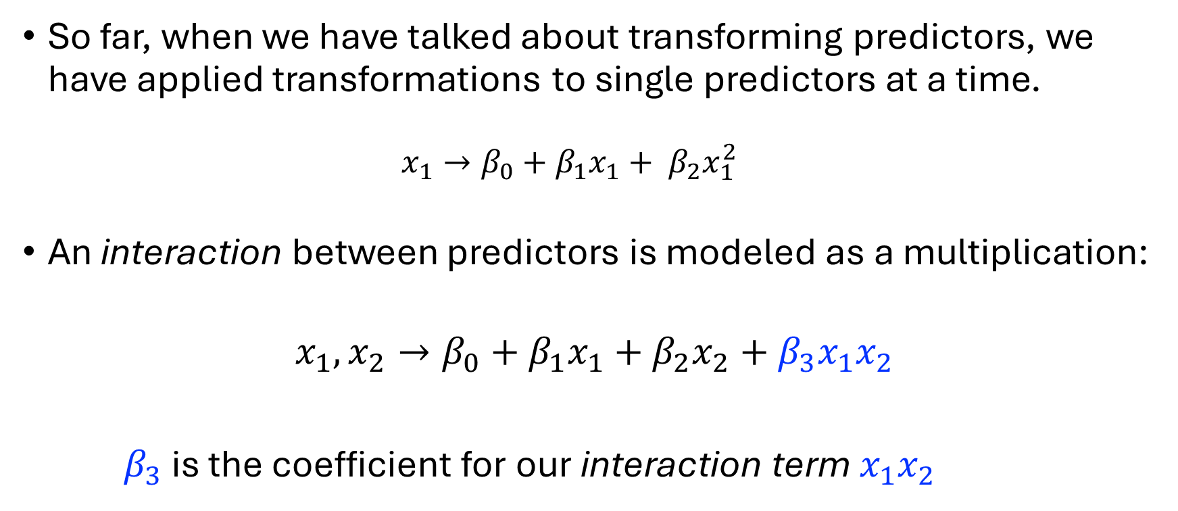
Interaction Terms
So far, when we have talked about transforming predictors, we have applied transformations to single predictors at a time.
$$x_{1}→β_{0}+β_{1}x_{1}+ β_{2}x_{1}^{2}$$
An interaction between predictors is modeled as a multiplication:
$$x_{1},x_{2}→β_{0}+β_{1}x_{1}+β_{2}x_{2}+β_{3}x_{1}x_{2}$$
$β_{3}$ is the coefficient for our interaction term $x_{1}x_{2}$

Slide 31
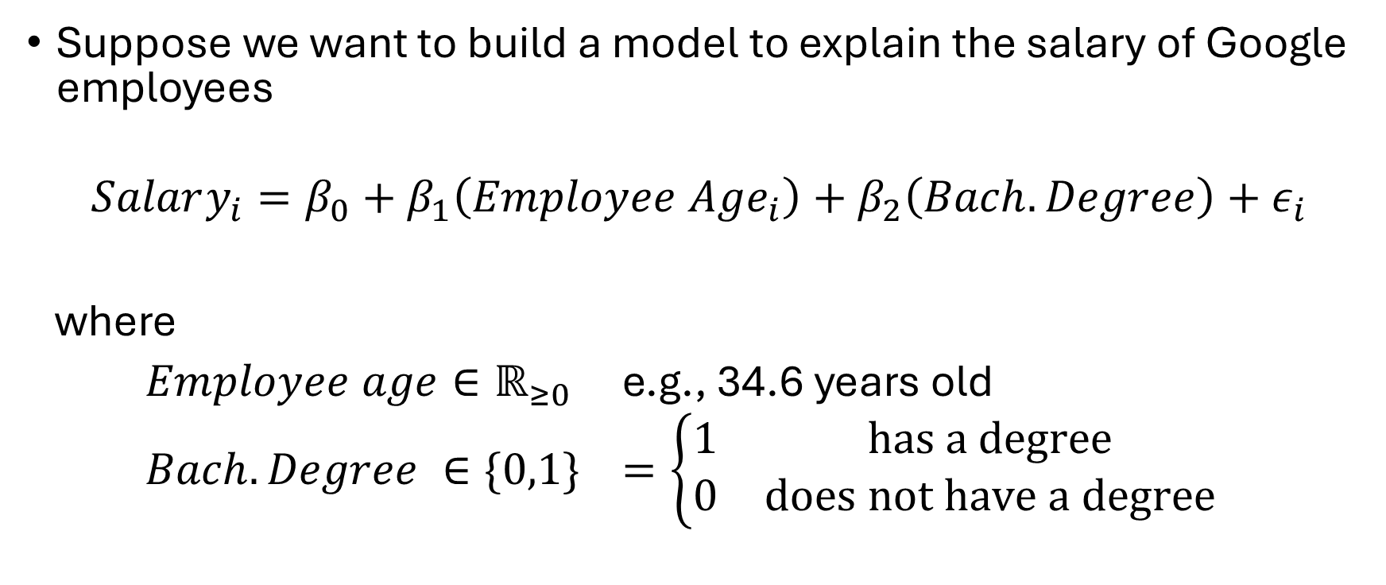
Intuition
Suppose we want to build a model to explain the salary of Google employees
$$Salary_{i}=β_{0}+β_{1}\left(Employee Age_{i}\right)+β_{2}\left(Bach. Degree\right)+ε_{i}$$
where
$Employee age∈ℝ_{≥0}$ e.g., 34.6 years old
$Bach. Degree ∈\{0,1\}$ $=\left\{\begin{matrix}1 & has a degree \\ 0 & does not have a degree\end{matrix}\right.$

Slide 32
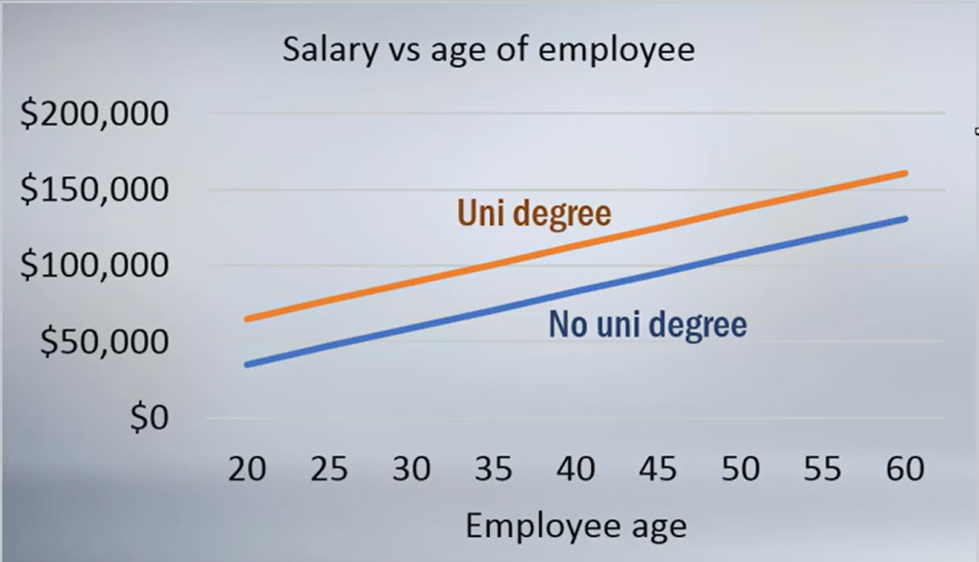
Google Employee Example
$$Salary_{i}=β_{0}+β_{1}\left(Employee Age_{i}\right)+β_{2}\left(Bach. Degree\right)+ε_{i}$$
Sourced from zedstatistics (See references slide)

Slide 33
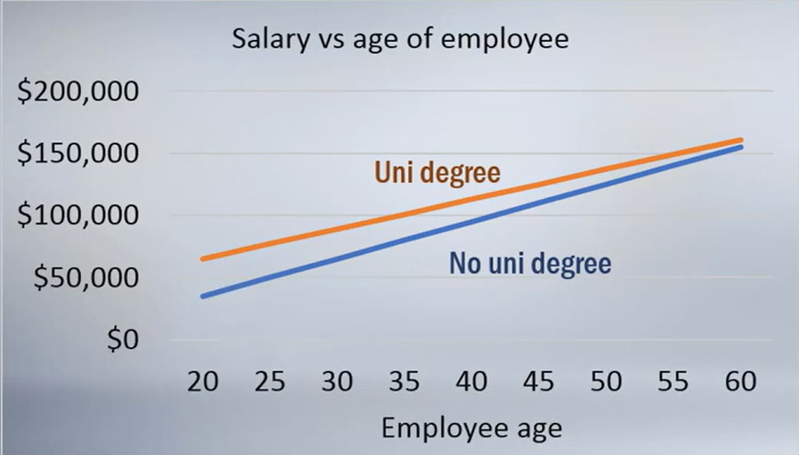
Google Employee Example
$$Salary_{i}=β_{0}+β_{1}\left(Employee Age_{i}\right)+β_{2}\left(Bach. Degree\right)+ε_{i}$$
Sourced from zedstatistics (See references slide)

Slide 34
Google Employee Example
$$Salary_{i}=β_{0}+β_{1}\left(Employee Age_{i}\right)+β_{2}\left(Bach. Degree\right)+β_{3}\left(Employee Age_{i}\right)\left(Bach. Degree\right)+ε_{i}$$
Sourced from zedstatistics (See references slide)

Slide 35
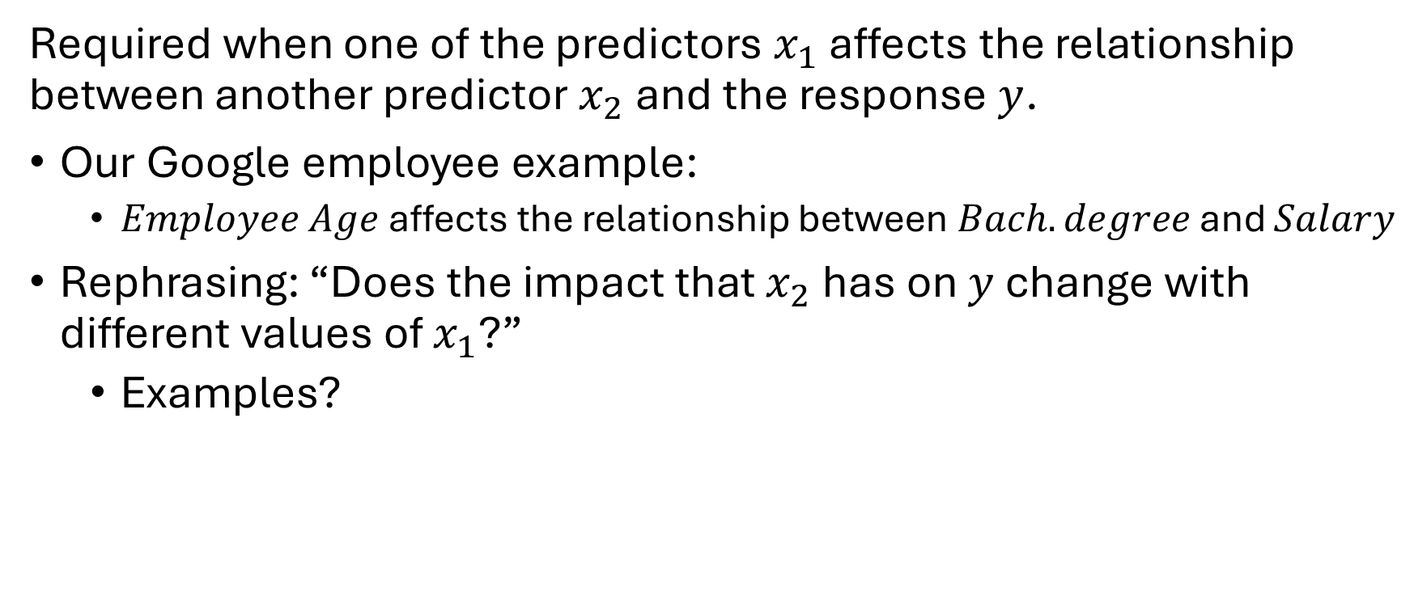
Interaction Terms
Required when one of the predictors $x_{1}$ affects the relationship between another predictor $x_{2}$ and the response $y$.
Our Google employee example:
$Employee Age$ affects the relationship between $Bach. degree$ and $Salary$
Rephrasing: “Does the impact that $x_{2}$ has on $y$ change with different values of $x_{1}$?”
Examples?
Notes:
Dosage vs age on medication effects
Exercise vs diet on reduction of cholesterol
Aircraft weight vs headwind on fuel consumption per nautical mile

Slide 36
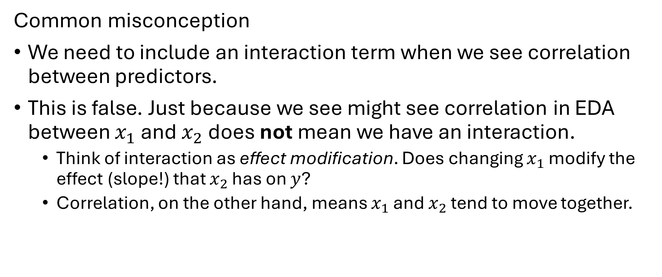
What Interaction Terms are NOT
Common misconception
We need to include an interaction term when we see correlation between predictors.
This is false. Just because we see might see correlation in EDA between $x_{1}$ and $x_{2}$ does not mean we have an interaction.
Think of interaction as effect modification. Does changing $x_{1}$ modify the effect (slope!) that $x_{2}$ has on $y$?
Correlation, on the other hand, means $x_{1}$ and $x_{2}$ tend to move together.

Slide 37
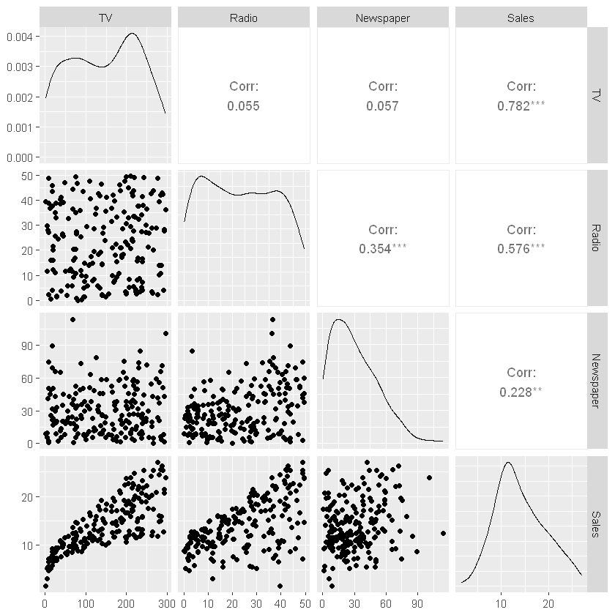
Revisiting the advertising Dataset
We saw correlation between Newspaper and Radio.
Intuitively: Do we think there is an interaction here?

Slide 38
Let’s check this in R
And get a little GenAI practice…

Slide 39
Another Example: Health Insurance Data
Suppose we have a set of data to model health insurance costs from various demographics and lifestyle variables.
Response variable- charges := medical costs billed by health insurance
Predictors-
bmi := body mass index in kg/m²
smoker := yes/no
A person with low bmi and doesn’t smoke might expect to have lower insurance charges.

Slide 40
Another Example: Health Insurance Data
Suppose we have a set of data to model health insurance costs from various demographics and lifestyle variables.
Response variable- charges := medical costs billed by health insurance
Predictors-
bmi := body mass index in kg/m²
smoker := yes/no
What about a smoker? They might have higher charges but the smoking keeps their weight lower*.
*This is not an argument in favor of smoking!

Slide 41
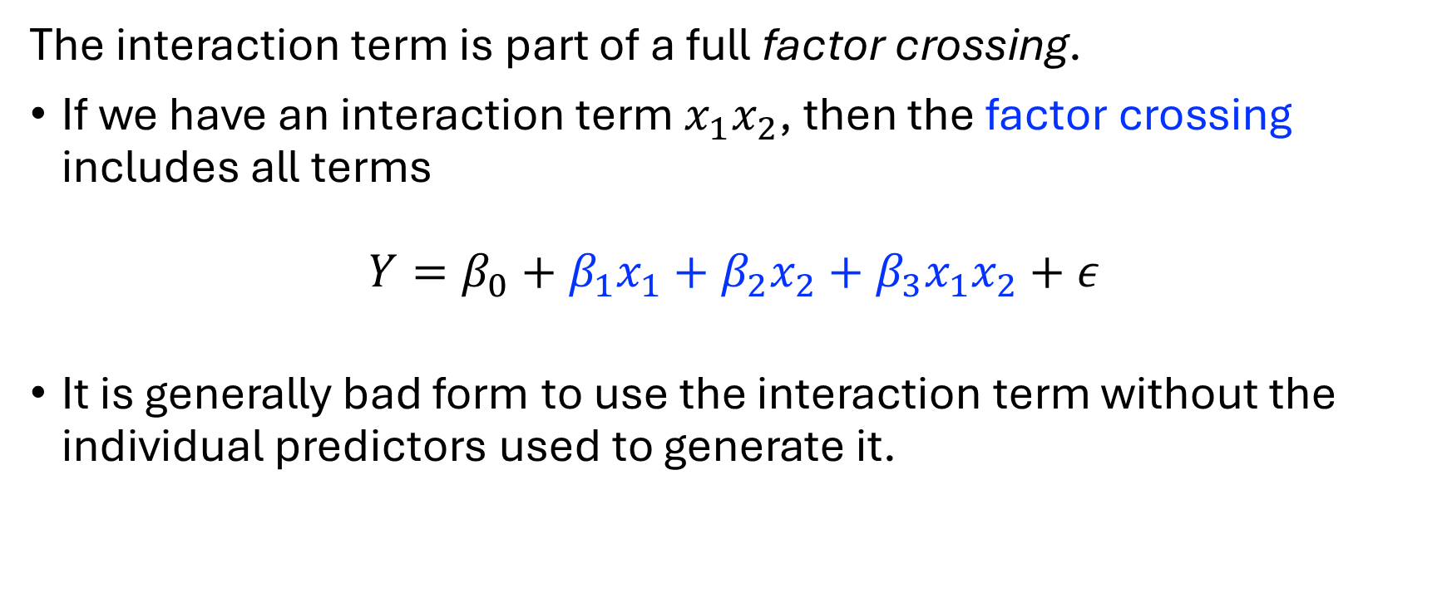
Interactions
The interaction term is part of a full factor crossing.
If we have an interaction term $x_{1}x_{2}$, then the factor crossing includes all terms
$$Y=β_{0}+β_{1}x_{1}+β_{2}x_{2}+β_{3}x_{1}x_{2}+ε$$
It is generally bad form to use the interaction term without the individual predictors used to generate it.

Slide 42
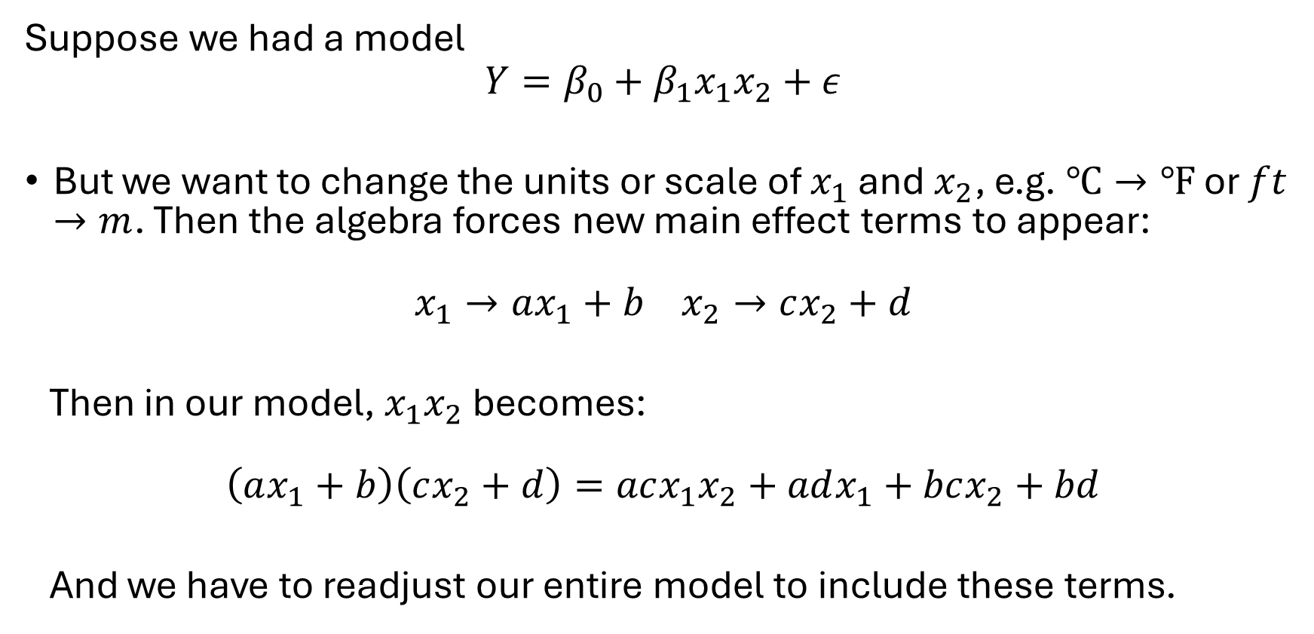
Interactions without Original Predictors
Suppose we had a model
$$Y=β_{0}+β_{1}x_{1}x_{2}+ε$$
But we want to change the units or scale of $x_{1}$ and $x_{2}$, e.g. $℃→℉$ or $ft →m$. Then the algebra forces new main effect terms to appear:
$$x_{1}→ax_{1}+b x_{2}→cx_{2}+d$$
Then in our model, $x_{1}x_{2}$ becomes:
$$\left(ax_{1}+b\right)\left(cx_{2}+d\right)=acx_{1}x_{2}+adx_{1}+bcx_{2}+bd$$
And we have to readjust our entire model to include these terms.

Slide 43
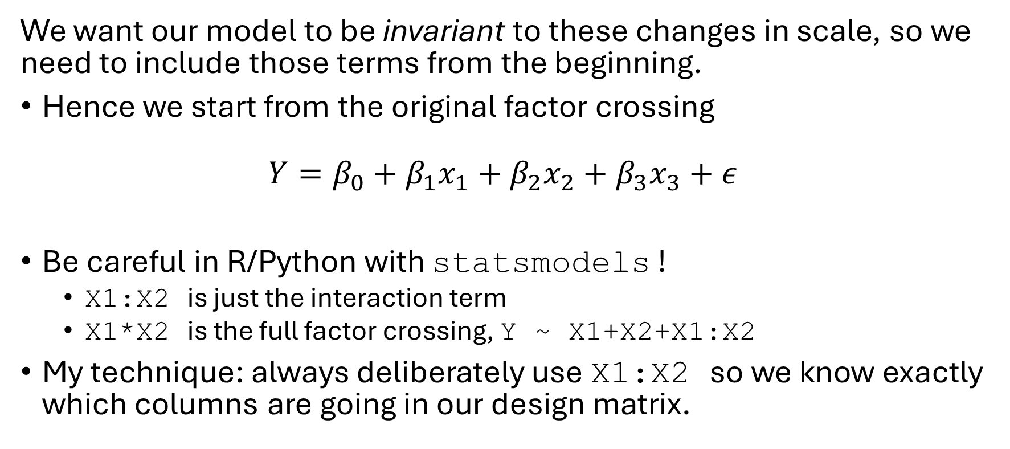
Interactions without Original Predictors
We want our model to be invariant to these changes in scale, so we need to include those terms from the beginning.
Hence we start from the original factor crossing
$$Y=β_{0}+β_{1}x_{1}+β_{2}x_{2}+β_{3}x_{3}+ε$$
Be careful in R/Python with statsmodels !
X1:X2 is just the interaction term
X1*X2 is the full factor crossing, Y ~ X1+X2+X1:X2
My technique: always deliberately use X1:X2 so we know exactly which columns are going in our design matrix.

Slide 44

Interaction + Categorical Variables
The health insurance dataset we discussed earlier would include the following predictors in the factor crossing:
$$x_{bmi} , x_{smoker}, x_{bmi}⋅x_{smoker}$$

Slide 45
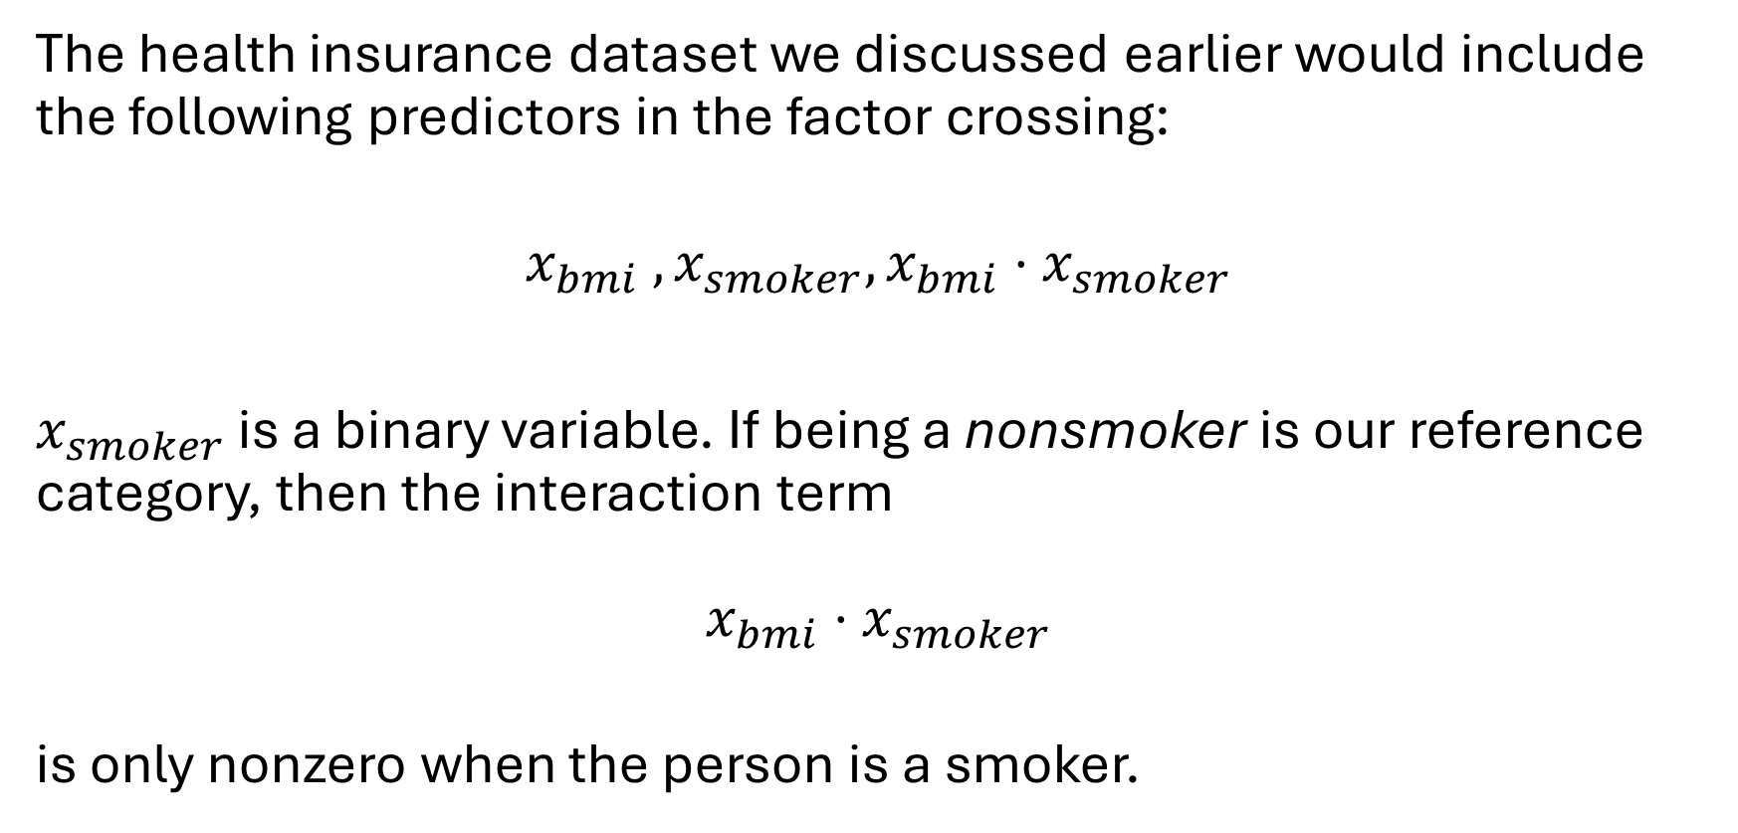
Interaction + Categorical Variables
The health insurance dataset we discussed earlier would include the following predictors in the factor crossing:
$$x_{bmi} , x_{smoker}, x_{bmi}⋅x_{smoker}$$
$x_{smoker}$ is a binary variable. If being a nonsmoker is our reference category, then the interaction term
$$x_{bmi}⋅x_{smoker}$$
is only nonzero when the person is a smoker.

Slide 46
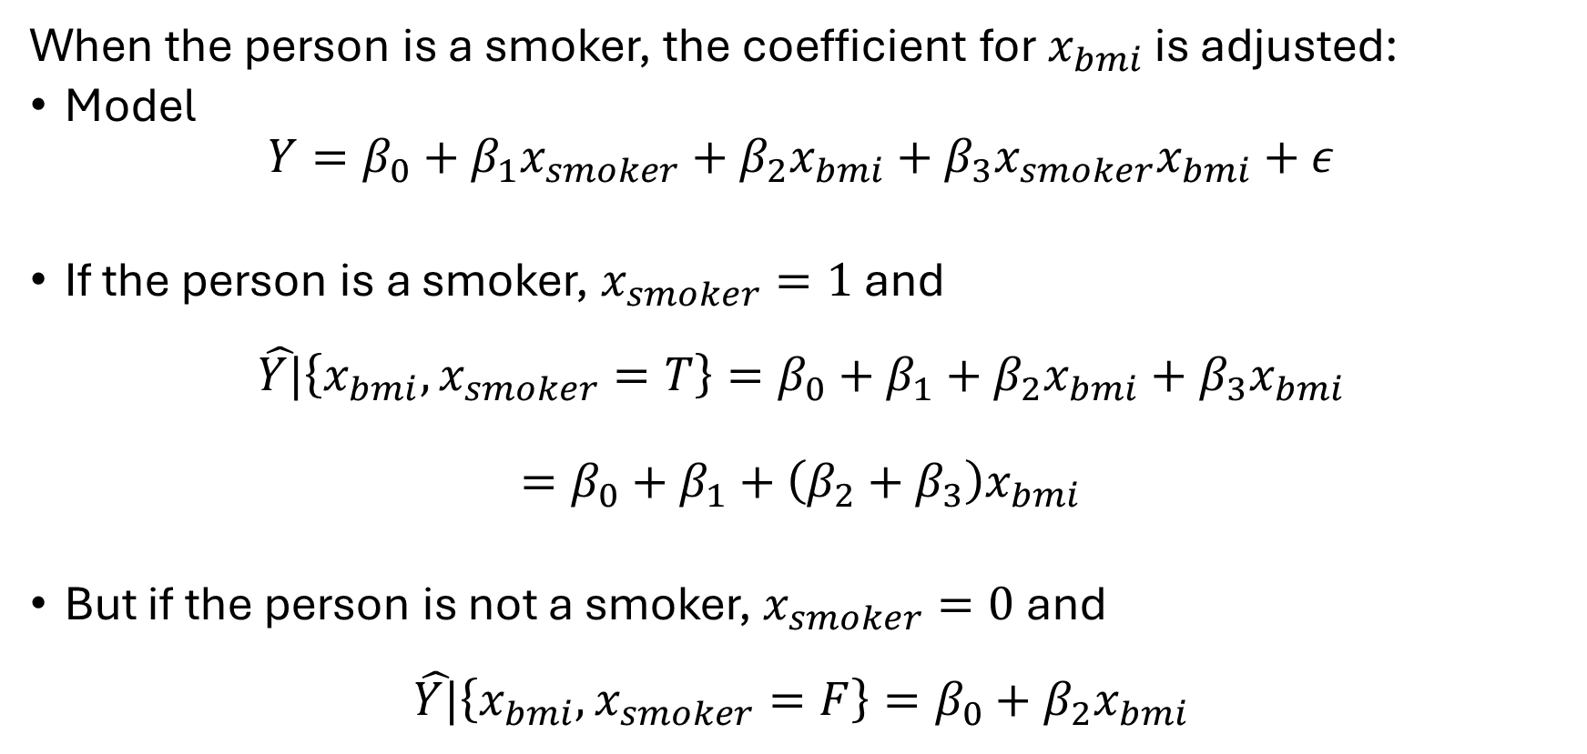
Interaction + Categorical Variables
When the person is a smoker, the coefficient for $x_{bmi}$ is adjusted:
Model
$$Y=β_{0}+β_{1}x_{smoker}+β_{2}x_{bmi}+β_{3}x_{smoker}x_{bmi}+ε$$
If the person is a smoker, $x_{smoker}=1$ and
$$\hat{Y|}\left\{x_{bmi},x_{smoker}=T\right\}=β_{0}+β_{1}+β_{2}x_{bmi}+β_{3}x_{bmi}$$
$$=β_{0}+β_{1}+\left(β_{2}+β_{3}\right)x_{bmi}$$
But if the person is not a smoker, $x_{smoker}=0$ and
$$\hat{Y|}\left\{x_{bmi},x_{smoker}=F\right\}=β_{0}+β_{2}x_{bmi}$$

